Slide 1
Computer Organization and Architecture
A TOP-LEVEL VIEW OF COMPUTER FUNCTION AND INTERCONNECTION
Dr John O’Donoghue

Slide 2
Topics
Computer Components
Computer Function
Interconnection Structures
Bus Interconnection
PC Buses

Slide 3
Computer Components
Three key concepts of von Neumann Architecture
Data and instructions are stored in a single R/W memory
Contents of memory are addressable by location, without regard to the type of data contained there
Execution occurs in a sequential fashion (unless explicitly modified), from one execution to the next.
Basic overview of the von Neumann Architecture
www.computerscience.gcse.guru/theory/von-neumann-architecture
http://cybercomputing.blogspot.ie/2012/02/von-neumann-architecture.html

Slide 4
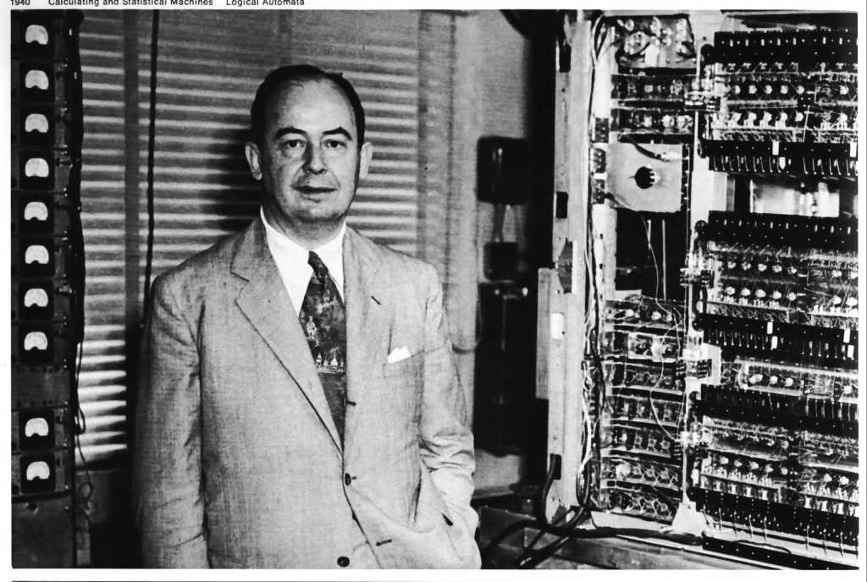
John von Neumann

Slide 5
Program Concept (1)
Hardware programming
Customized hardware for a particular computation
Rewiring hardware for new program
Hardwired systems are inflexible
General purpose hardware can do different tasks, given correct control signals
Instead of re-wiring, supply a new set of control signals

Slide 6
Program Concept (2)
Software programming
General-purpose configuration of arithmetic and logic function
What is a program?
A sequence of steps
For each step, an arithmetic or logical operation is done
For each operation, a different set of control signals is needed and applied to the hardware
Instruction codes ⇒ control signals
New program ⇒ New instruction codes

Slide 7
System Components (1)
CPU
Instruction interpreter
General-purpose arithmetic and logic
functions module
Memory
Temporary storage of code and results
I/O modules
Data and instructions need to get into
the system and results out

Slide 8
System Components (2)
CPU
Control Unit: hardware segment accepts codes and issues control signals
Arithmetic and Logic Unit
CPU registers
PC (program counter): address of next instruction to execute
IR (instruction register): current instruction being executed
MAR (memory address register): address in memory for next R/W => Load/Store
MBR (memory buffer register): data to be written/read to/from memory
I/O AR: particular I/O device
I/O BR: data exchanged between CPU and I/O module

Slide 9
System Components (3)
Memory
A set of locations defined by sequentially numbered addresses
I/O Module
Contains buffers for temporarily holding data to be exchanged with memory and CPU

Slide 10
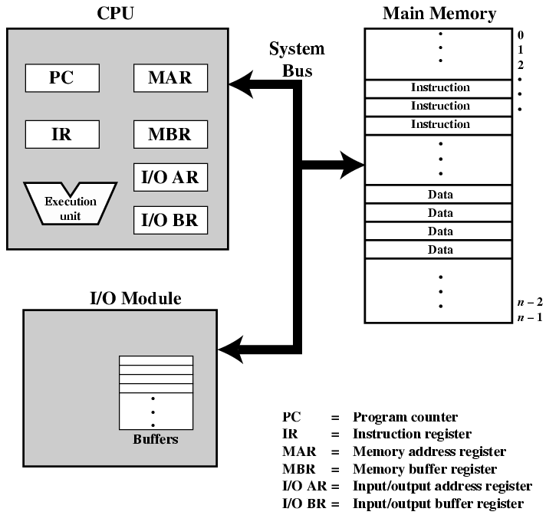
Computer Components: Top Level View

Slide 11
Computer Function
Basic function?
Program execution
Program?
A set of instructions

Slide 12
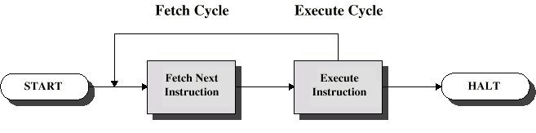
Instruction Cycle
Two steps:
Fetch: CPU reads instructions from memory
Execute
Instruction cycle = fetch cycle + execution cycle

Slide 13
Fetch Cycle
How do we know which instruction is next to fetch (i.e. where can we find it)?
Program Counter (PC or Instruction Pointer IP) holds address of next instruction to fetch
Processor fetches instruction from memory location pointed to by PC
Increment PC (to next address in memory, unless told otherwise
Where is the fetched instruction stored?
Instruction Register (IR)
Processor interprets instruction and performs required actions

Slide 14
Execute Cycle
Processor-memory
data transfer between CPU and main memory
Processor I/O
Data transfer between CPU and I/O module
Data processing
Some arithmetic or logical operation on data
Control
Alteration of sequence of operations
e.g. jump
Combination of above
Animation
www.youtube.com/watch?v=xfJbpCJSpd8

Slide 15
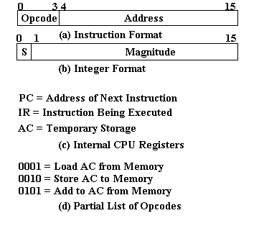
Example of Program Execution
Characteristics of a
Hypothetical Machine
Load = Read
Store = Write

Slide 16
Example of Program Execution
Want to perform: Loc₉₄₁ ← Loc₉₄₀ + Loc₉₄₁
One address format
LOAD 940; AC ← Loc₉₄₀
ADD 941; AC ← AC + Loc₉₄₁
STORE 941; Loc₉₄₁ ← AC
Hex representation of instruction
1940 = 0001 1001 0100 0000
e.g. OP-code of LOAD

Slide 17
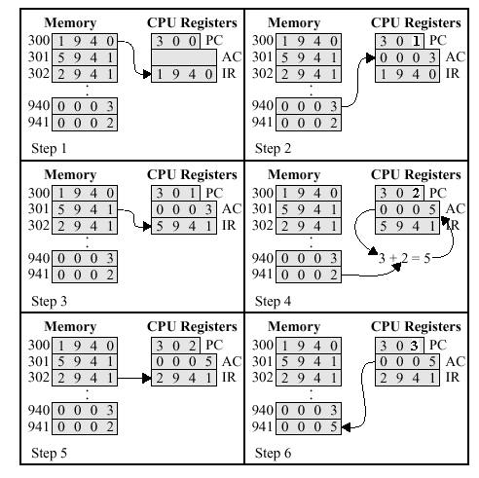
Example of Program Execution (Figure 3.5 in the text)

Slide 18
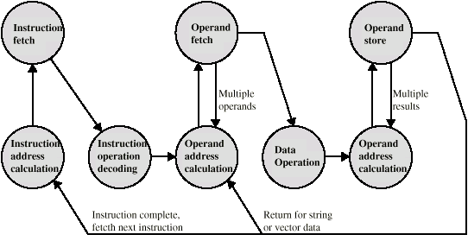
Instruction Cycle - State Diagram
Fetch = Load = Read

Slide 19
Instruction Cycle Cont’d

Slide 20
Interrupts
Mechanism by which other modules (e.g. I/O) may interrupt normal sequence of processing
Program
e.g. overflow, division by zero
Timer
Generated by internal processor timer
Used in pre-emptive multi-tasking
I/O
from I/O controller, completion of I/O or error
Hardware failure
e.g. memory parity error, power failure

Slide 21
Why are Interrupts Useful?
Devices are slow, using an interrupt improves processing efficiency by..
letting CPU execute its normal instruction sequence and
pause to service the external devices when they signal that they are ready for CPU’s attention

Slide 22
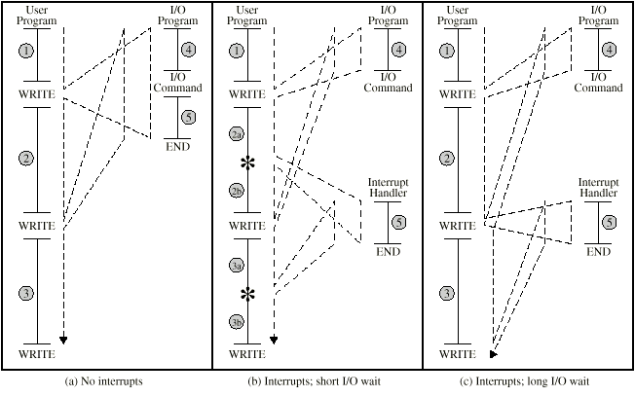
Program Flow Control (1)

Slide 23
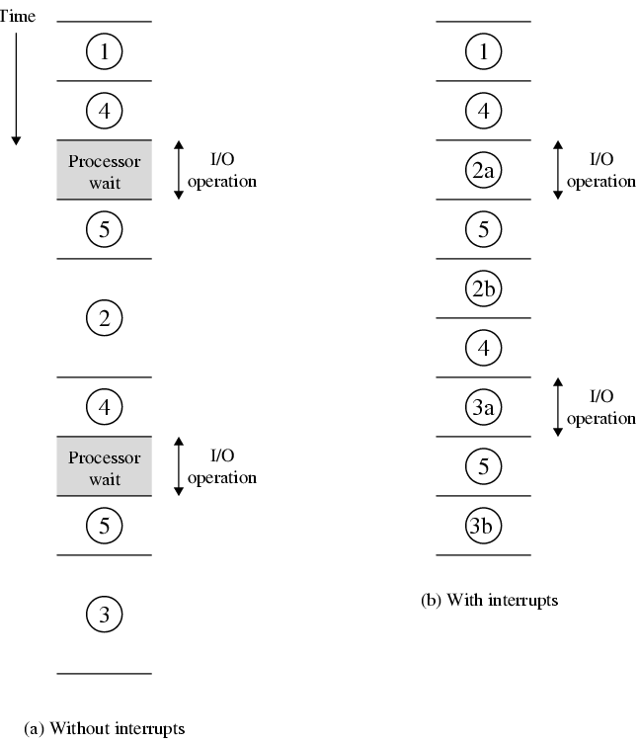
Program Timing Short I/O Wait

Slide 24
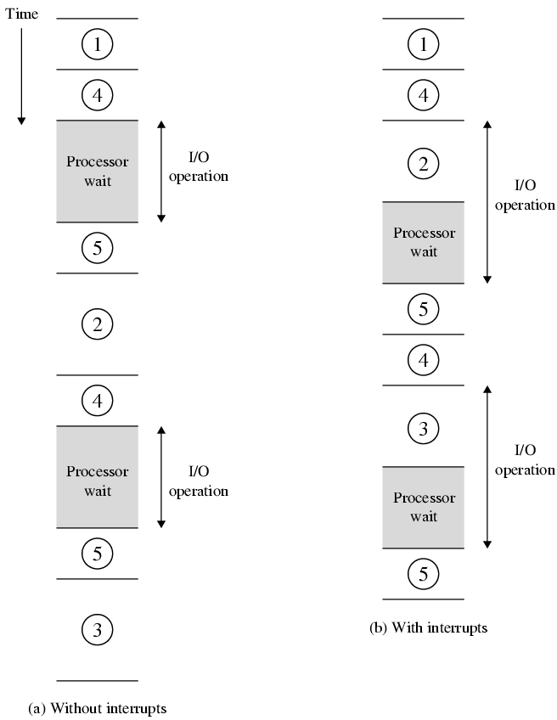
Program Timing Long I/O Wait

Slide 25
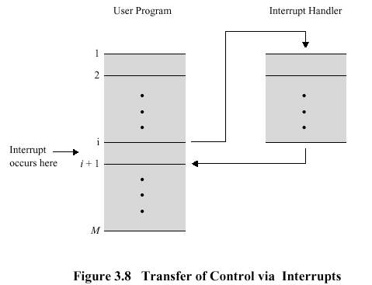
Program Flow Control (2)

Slide 26
Interrupt Cycle
Added to instruction cycle
Processor checks for interrupt
Indicated by an interrupt signal
If no interrupt, fetch next instruction
If interrupt pending:
Suspend execution of current program
Save context
Set PC to start address of interrupt handler routine
Process interrupt
Restore context and continue interrupted program

Slide 27
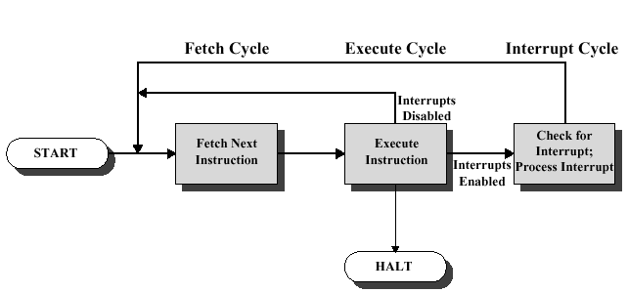
Instruction Cycle with Interrupts

Slide 28
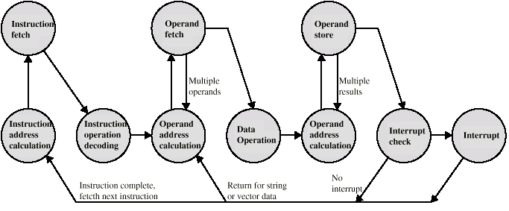
Instruction Cycle (with Interrupts) - State Diagram

Slide 29
Multiple Interrupts
Disable interrupts - Sequential approach
Processor will ignore further interrupts whilst processing one interrupt
Interrupts remain pending and are checked after first interrupt has been processed
Interrupts handled in sequence as they occur
Define priorities - Nested approach
Low priority interrupts can be interrupted by higher priority interrupts
When higher priority interrupt has been processed, processor returns to previous interrupt

Slide 30
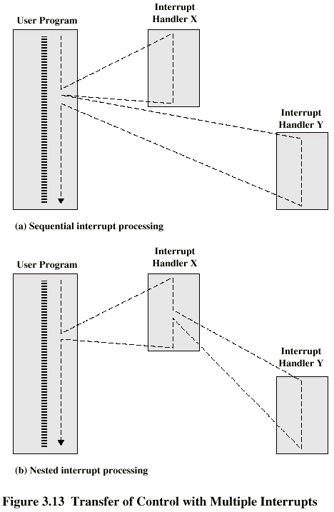
Multiple Interrupts - Sequential

Slide 31
Multiple Interrupts - Nested

Slide 32
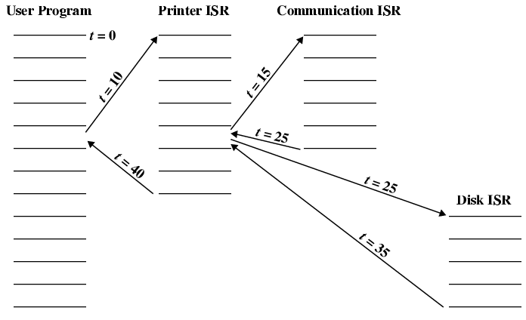
Time Sequence of Multiple Interrupts

Slide 33
Interconnection Structures
All the units must be connected
Interconnection structure:
The collection of paths connecting system modules
Different type of connection for different type of unit
Memory
Input/Output
CPU
Design depends on necessary exchanges between modules

Slide 34
Data Transfer
Memory → CPU
CPU → Memory
I/O → CPU
CPU → I/O
I/O ↔ Memory (?)
DMA: direct memory access

Slide 35
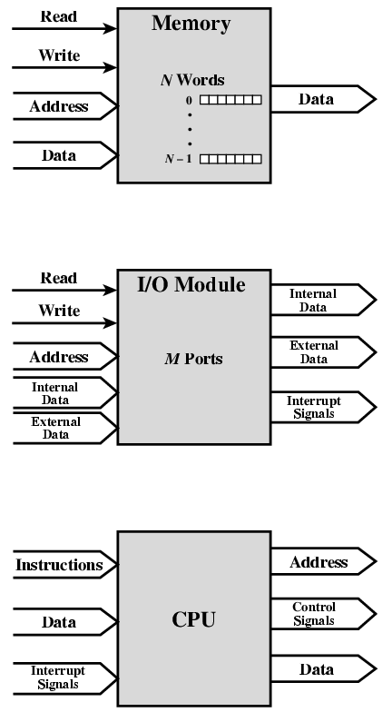
Computer Modules

Slide 36
Memory Connection
Receives and sends data
Receives addresses (of locations)
Receives control signals
Read
Write
Timing

Slide 37
Input/Output Connection(1)
Similar to memory from computer’s viewpoint
Output
Receive data from computer
Send data to peripheral
Input
Receive data from peripheral
Send data to computer

Slide 38
Input/Output Connection(2)
Receive control signals from computer
Send control signals to peripherals
e.g. spin disk
Receive addresses from computer
e.g. port number to identify peripheral
Send interrupt signals (control)

Slide 39
CPU Connection
Reads instruction and data
Writes out data (after processing)
Sends control signals to other units
Receives (& acts on) interrupts

Slide 40
Bus Interconnection (1)
Bus:
A communication pathway connecting two or more devices
Characteristics
Shared
Usually broadcast
must ensure only one device transmitting at a time
Often grouped
A number of channels in one bus
e.g. 32 bit data bus is 32 separate single bit channels

Slide 41
Buses Interconnection (2)
There are a number of possible interconnection systems
Single and multiple BUS structures are most common
e.g. Control/Address/Data bus (PC)
e.g. Unibus (DEC-PDP)

Slide 42
System Bus
Bus that connects major computer components
Typically 50-100 separate lines
Three functional groups of lines
Data
Address
Control
Misc. lines
power
ground
clock

Slide 43
Data Bus
Carries data
I.e., moves data between system modules
Remember that there is no difference between “data” and “instruction” at this level
Width is a key determinant of performance
Number of lines (1 bit carried by a line at a time)
Determines number of bits can be transferred at a time
8, 16, 32, 64 bit

Slide 44
Address bus
Identify the source or destination of data
e.g. CPU needs to read an instruction (data) from a given location in memory or an I/O port
Width determines maximum memory capacity of system
e.g. 8080 has 16 bit address bus giving 64k address space

Slide 45
Control Bus
Control and timing information
Memory read/write signal
Interrupt request
Clock signals
access/use of data/address lines

Slide 46
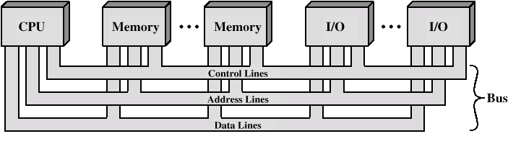
Bus Interconnection Scheme

Slide 47
Big and Yellow?
What do buses look like?
Parallel lines on circuit boards
Ribbon cables
Strip connectors on mother boards
e.g. PCI
Sets of wires

Slide 48
Bus Operation
Module wishing to send
1. Obtain use of bus
2. Transfer data via bus
Module wishing to receive
Obtain use of bus
Transfer request to the other module
Wait

Slide 49
Single Bus Problems
Lots of devices on one bus leads to:
Propagation delays
Long data paths mean that co-ordination of bus use can adversely affect performance
If aggregate data transfer approaches bus capacity
More devices, longer delay
Most systems use multiple buses to overcome these problems
Hierarchical
Traditional
High-performance

Slide 50
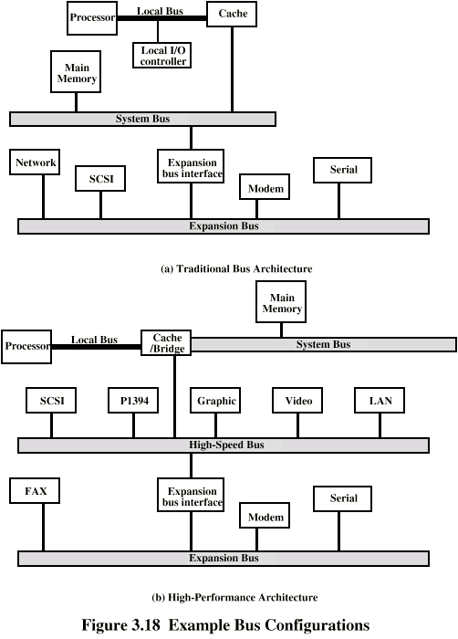
Traditional (ISA) (with cache)

Slide 51
High Performance Bus

Slide 52
Elements of Bus Design
Bus type
Bus width
Data transfer type
Arbitration method
Bus timing

Slide 53
Bus Types
Dedicated
Separate data & address lines
Multiplexed
Shared lines
Address valid or data valid control line
Advantage - fewer lines
Disadvantages
More complex control
Potential reduction in performance

Slide 54
Bus Width and Data Transfer Type
Bus width
Data
Address
Data transfer type
Read
Write
Read-modify-write: protecting shared memory
Read-after-write: checking
Block data transfer

Slide 55
Bus Arbitration
Why arbitration?
More than one module controlling the bus, e.g. CPU and DMA controller
We want to make sure that only one module can successfully transmit over bus at a time
Arbitration may be centralised or distributed

Slide 56
Centralised Arbitration
Single hardware device controlling bus access
Bus Controller
Arbiter
May be part of CPU or separate

Slide 57
Distributed Arbitration
Each module may claim the bus
Control logic on all modules

Slide 58
PCI Bus
Peripheral Component Interconnection
Intel released to public domain
32 or 64 bit
49 mandatory and 51 optional signal lines (see Tables 3.3 and 3.4, respectively)
Current standard
Up to 64 data lines at 66Mhz
Q: what is the max raw transfer rate?

Slide 59
Foreground Reading
Stallings, chapter 3
www.pcguide.com/ref/mbsys/buses/

